Slide 1
Java Basics
Syntax, and Core Concepts
Presented By: Mirazul Islam Java Instructor, EU

Slide 2
Features of Java
Java
Object Oriented
Secured
Platform Independent
Multi
threading

Slide 3
Applications of Java
Desktop GUI
Mobile App
Game Development
Web Based App
Enterprise
Scientific

Slide 4
Key Differences Between Java and C++
Feature | Java | C++
Paradigm | Purely Object-Oriented (except for primitive types) | Supports both Procedural and Object-Oriented Programming
Platform Dependency | Platform-Independent (Runs on JVM) | Platform-Dependent (Compiled to Machine Code)
Memory Management | Automatic Garbage Collection | Manual Memory Management (new/delete)
Multiple Inheritance | Not supported (Uses Interfaces) | Supported
Pointers | Does not support explicit pointers (for security) | Fully supports pointers
Compilation & Execution | Compiled to Bytecode and runs on JVM | Compiled directly to machine code
Speed & Performance | Slightly slower due to JVM overhead | Faster as it compiles to native code

Slide 5
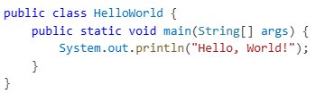
Sample Java Program
Java Source Code (.java file)
Java Compiler
Bytecode File (.class file)
JVM
Machine Code

Slide 6
Data Types in Java
Data Type
Primitive
Non-Primitive
string
Boolean
Numeric
array
etc.
Character
Integral
Integer
Float
byte
boolean
char
short
float
int
double
long

Slide 7
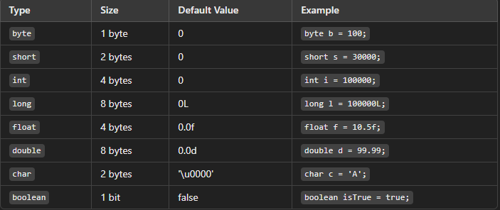
Primitive data types

Slide 8
Type Casting in Java
Converting a variable from one data type to another.
Implicit Casting (Widening Conversion)
Automatically done by Java.
Converts a smaller type to a larger type.
Examples:
int → long → float → double int a = 10;
double b = a; // Implicit casting

Slide 9
Type Casting in Java
Explicit Casting (Narrowing Conversion)
Must be done manually using a cast operator.
Converts a larger type to a smaller type.
Risk of data loss.
Example:
double x = 9.8;
int y = (int) x; // Explicit casting

Slide 10
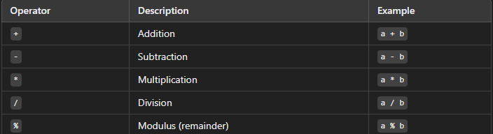
Operators in Java
Mathematical operations.

Slide 11
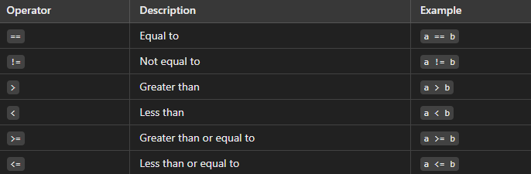
Relational (Comparison) Operators
int x = 5, y = 10; System.out.println(x < y); // Output: true

Slide 12
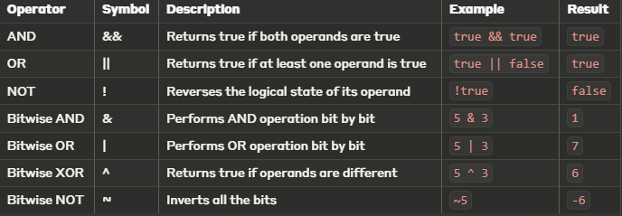
Logical Operators

Slide 13
Java Comments
Single-line Comments
// This is a single-line comment
int age = 25;
Multi-line Comments
Use /* */ for longer explanations
/* This is a multi-line comment
used to explain logic in detail */
int result = a + b;

Slide 14
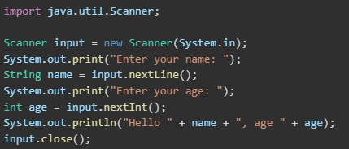
User Input in Java
import java.util.Scanner;
Scanner input = new Scanner(System.in);
Use methods like:
nextLine() → for strings
nextInt() → for integers
nextDouble() → for decimals
Always close with input.close();

Slide 15
Control Flow:
Control flow determines the order of execution of statements in Java.
Java provides different types of control flow statements: - Conditional Statements (if, if-else, switch)
- Looping Statements (for, while, do-while)
- Jump Statements (break, continue, return)

Slide 16


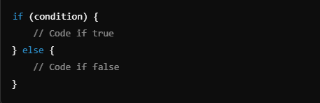
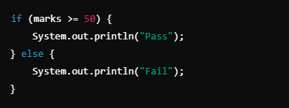
Conditional Statement

Slide 17
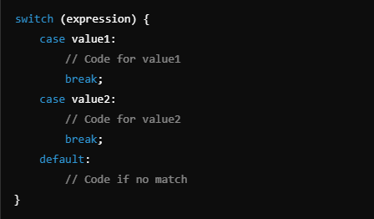
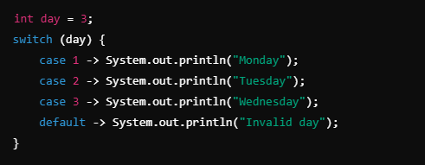

Slide 18

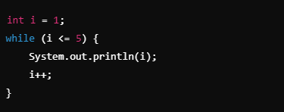

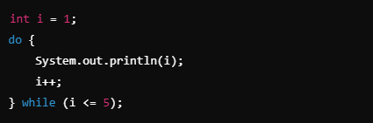

Looping Statement

Slide 19
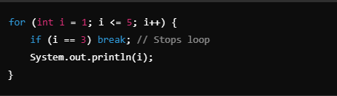
Jump Statement
Break statement (Exit Loop)

Slide 20
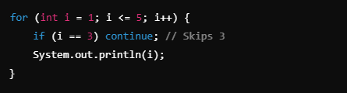
Jump Statement(Cont..)
Continue Statement(Skip Iteration)

Slide 21
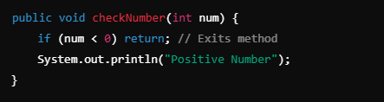
Jump Statement(cont..)
Return Statement(Exit Method)

Slide 22


Strings in Java
A String in Java is a sequence of characters.
Strings are immutable (once created, they cannot be changed).
Defined using the String class in Java
Stored in String Pool
Stored in Heap Memory

Slide 23


String Comparison
Using equals() (Checks content)
Using == Operator (Checks reference)

Slide 24
What is the String Pool?
String Pool (also known as String Intern Pool) is a special memory area in Java's Heap memory to optimize memory usage.
It stores unique string literals to save memory and improve performance.
Implements the concept of "string interning"

Slide 25
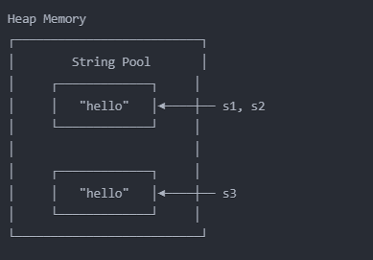


Slide 26
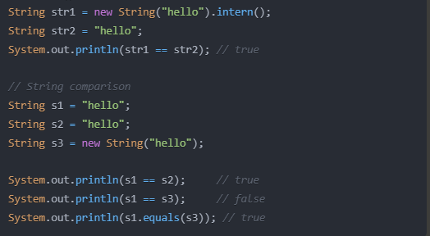

Slide 27
Problem Statement 1:
You are tasked with implementing a simple calculator that can perform basic arithmetic operations. The calculator should be able to perform addition, subtraction, multiplication, and division on two numbers provided by the user. After performing each operation, the program should allow the user to continue performing calculations until they choose to exit. Input: Enter first number: 7
Enter second number: 3
Enter operation (+, -, *, /): *
Do you want to perform another calculation? (yes/no): no Output: Result: 21.0
Thank you for using the calculator!

Slide 28
Problem Statement 2:
You are given a string s consisting of lowercase English letters and a character c. Your task is to determine how many times the character c appears in the string s.
Input: programming
g Output: 2

